Slide 1
Maze Assignment
Omar Elsewify
September 29th

Slide 2
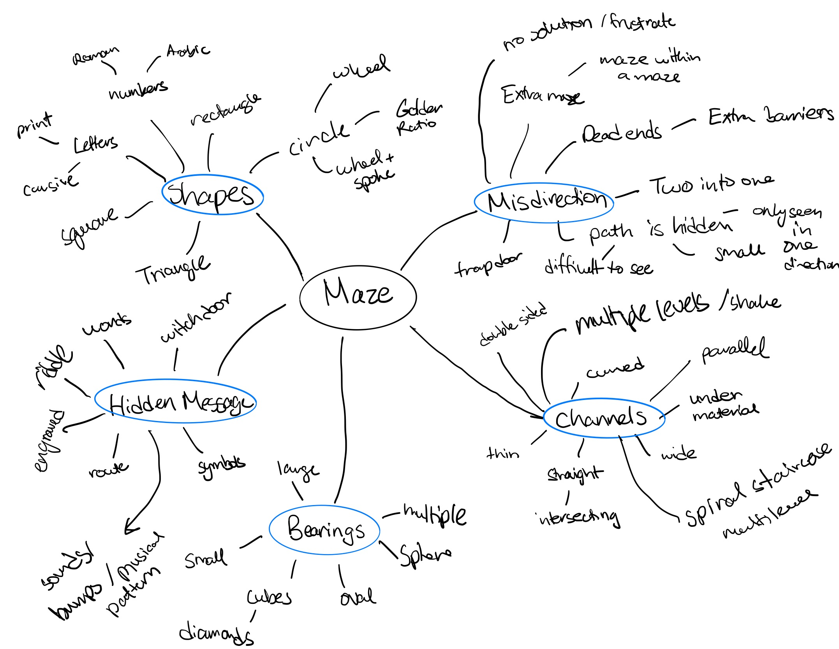
Process of Design Development:
10-minute mind map construction
Sketched an initial maze to experiment with maze building
Took inspiration from Coaching session and learnt maze building
Flared out as much as I could and tried to jump from one thought to another
Took each flared maze item and flared a bit more
Focused in a bit more on the designs I liked
Designed a final concept which brought together what I enjoyed
MY THOUGHT PROCESS

Slide 3
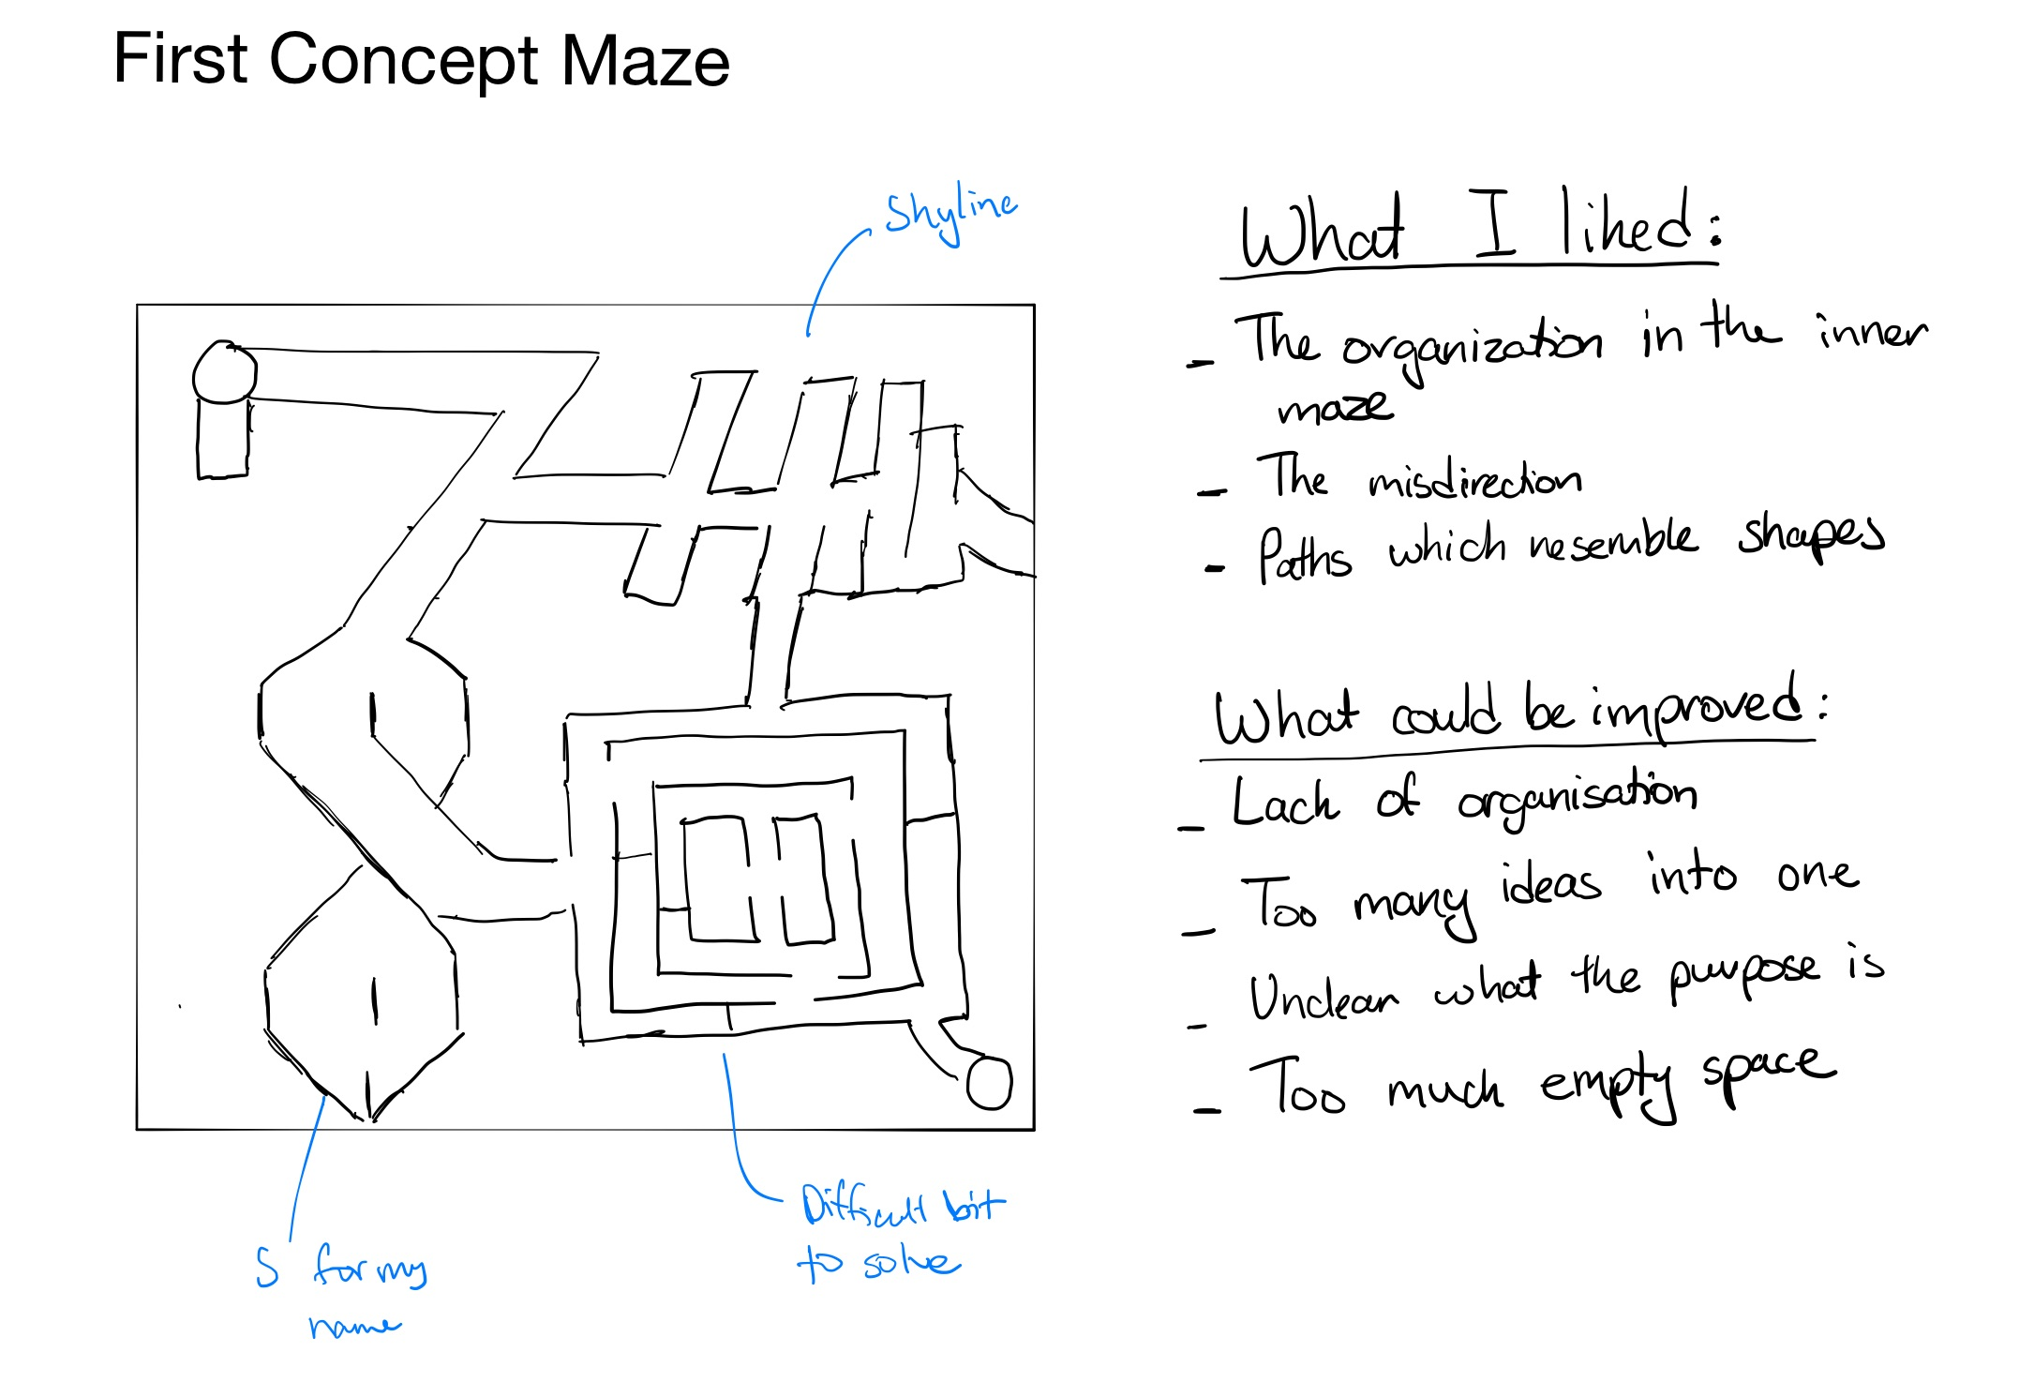

Slide 4
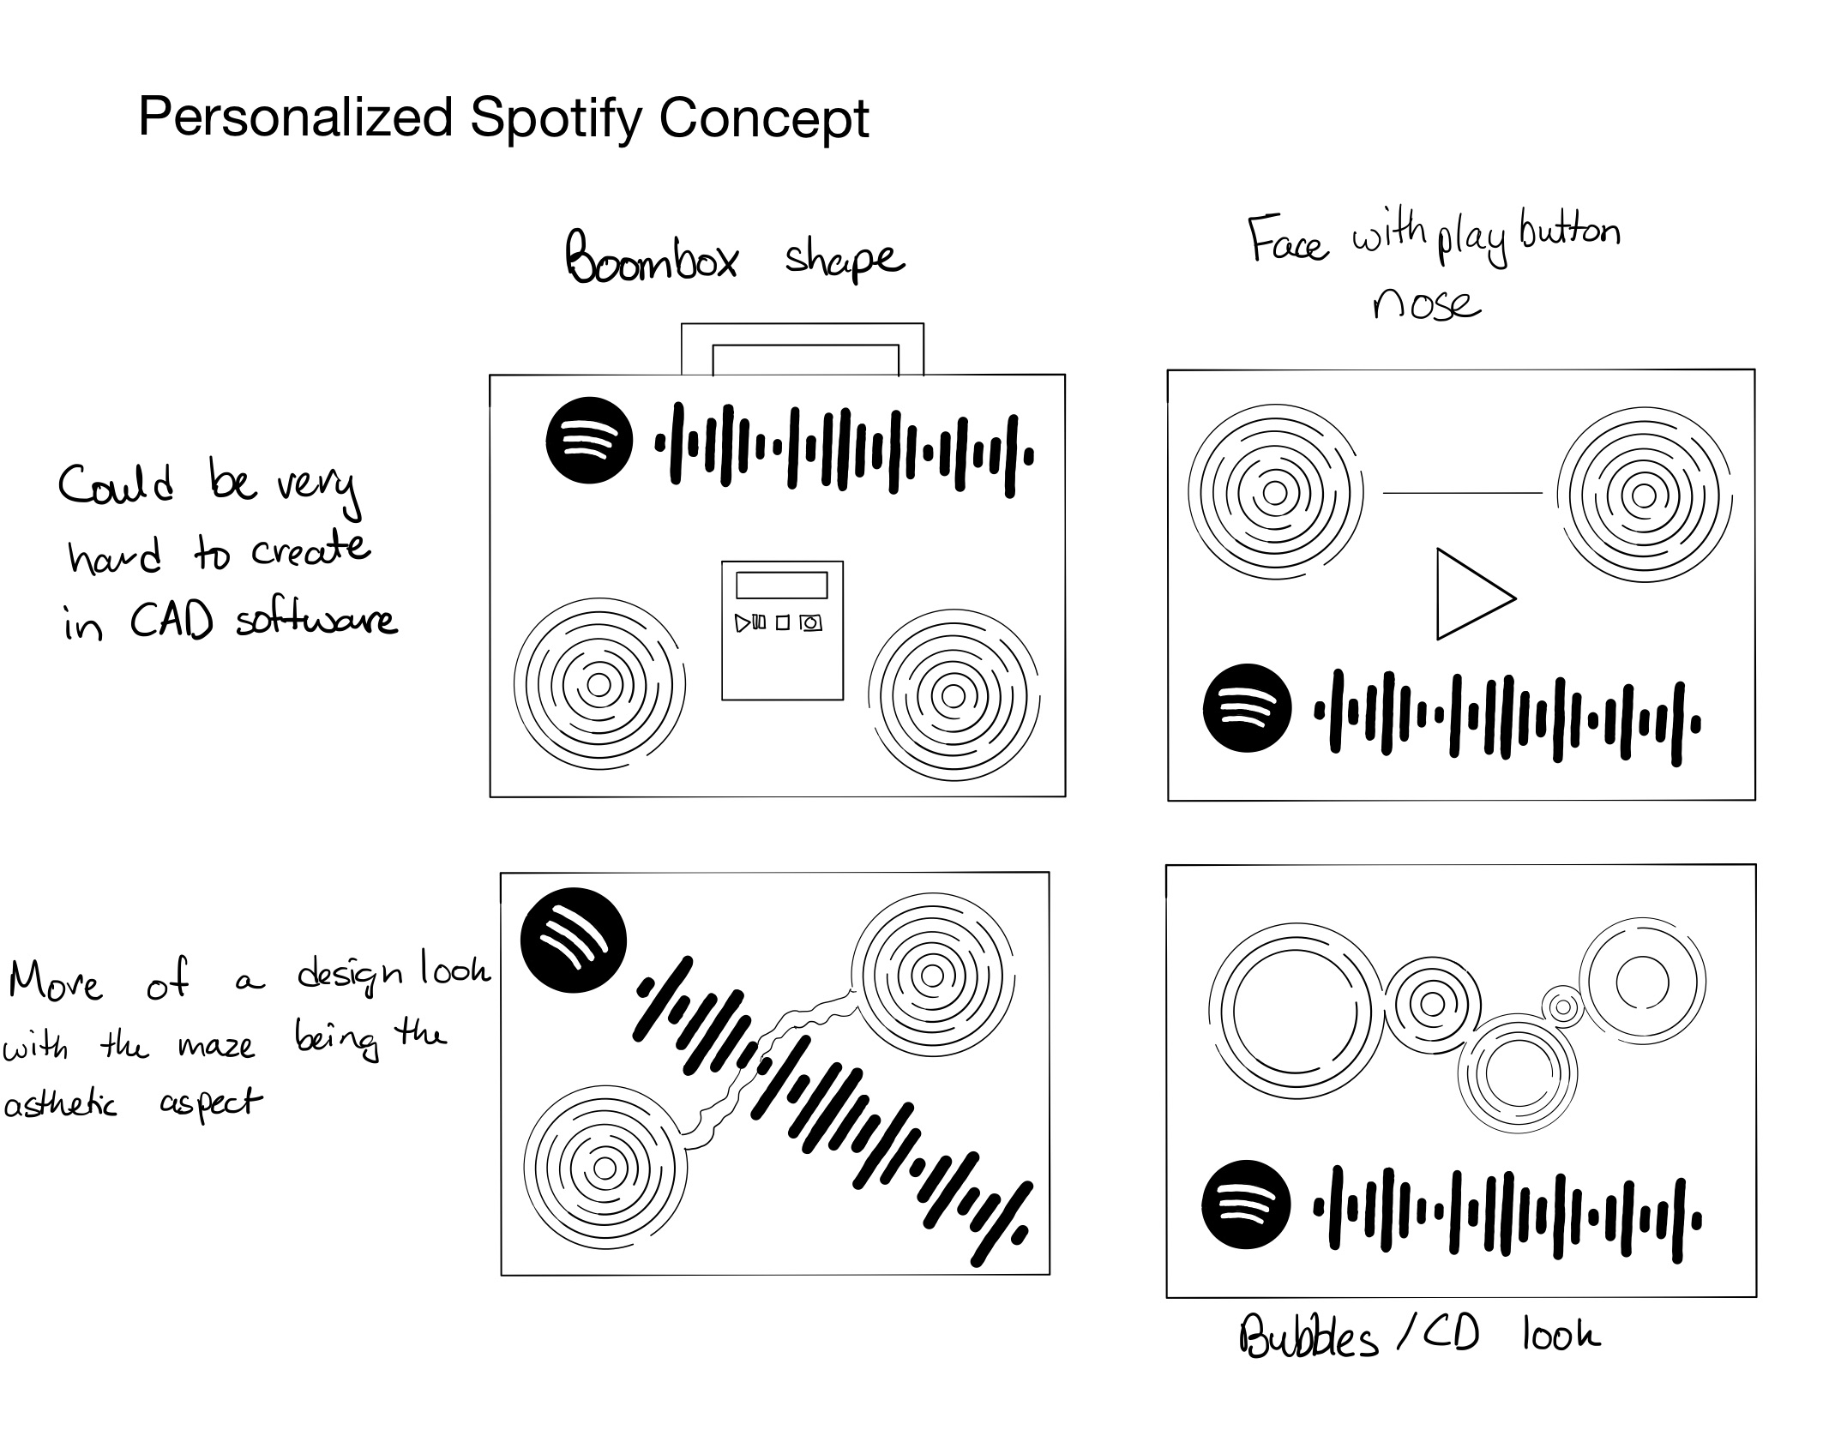

Slide 5
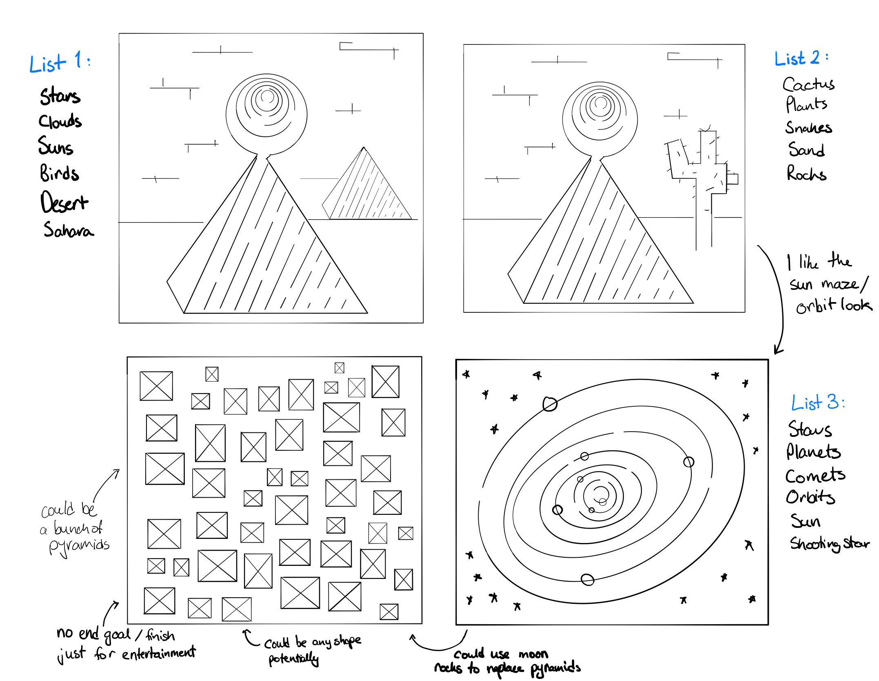

Slide 6
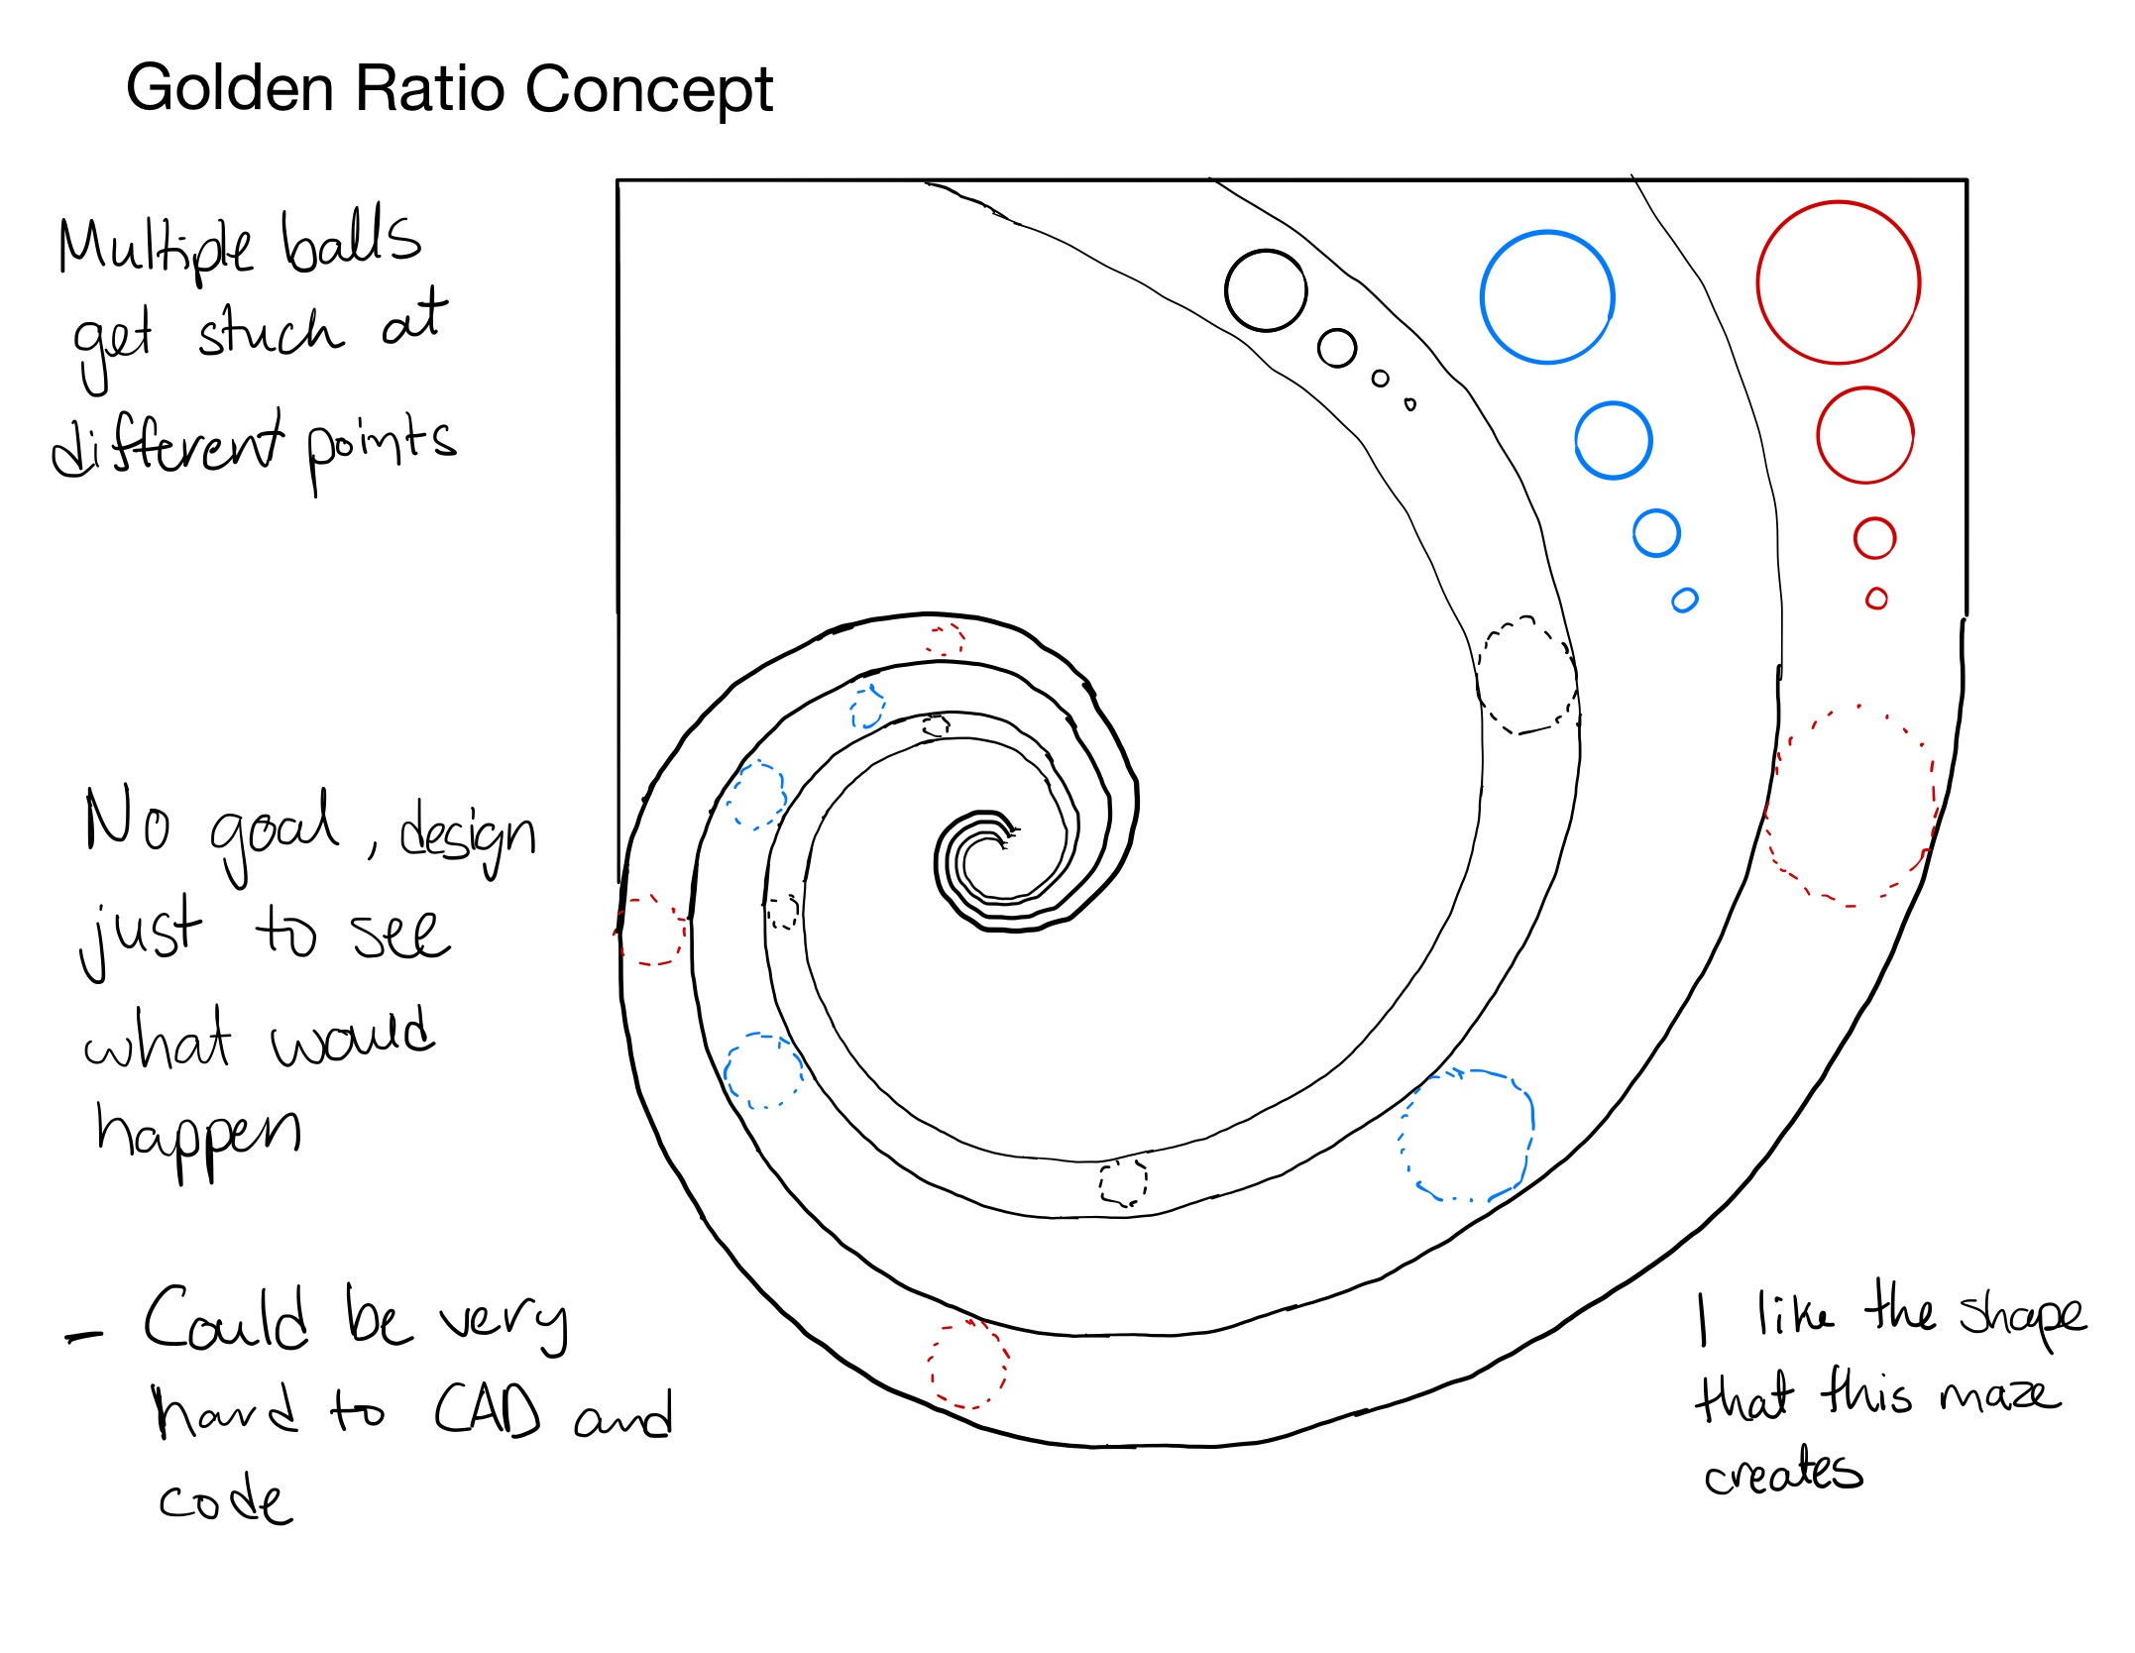

Slide 7
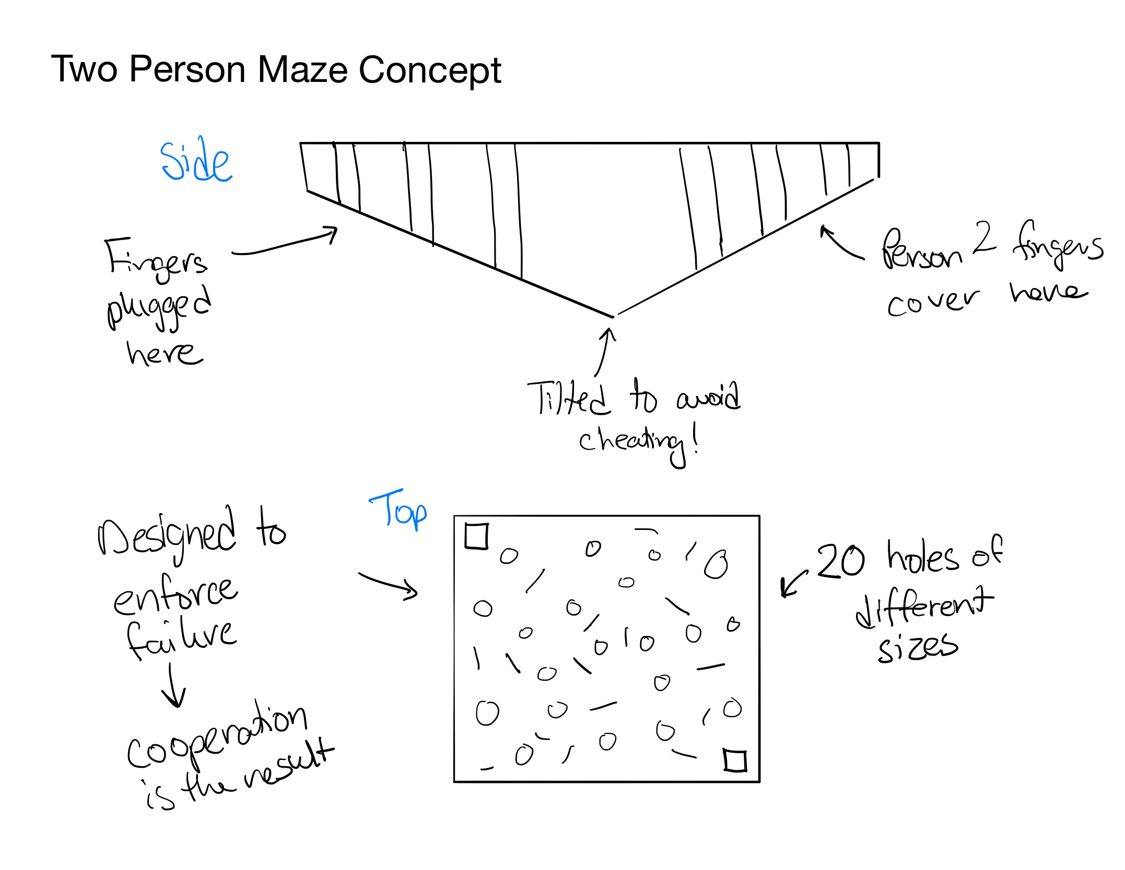

Slide 8
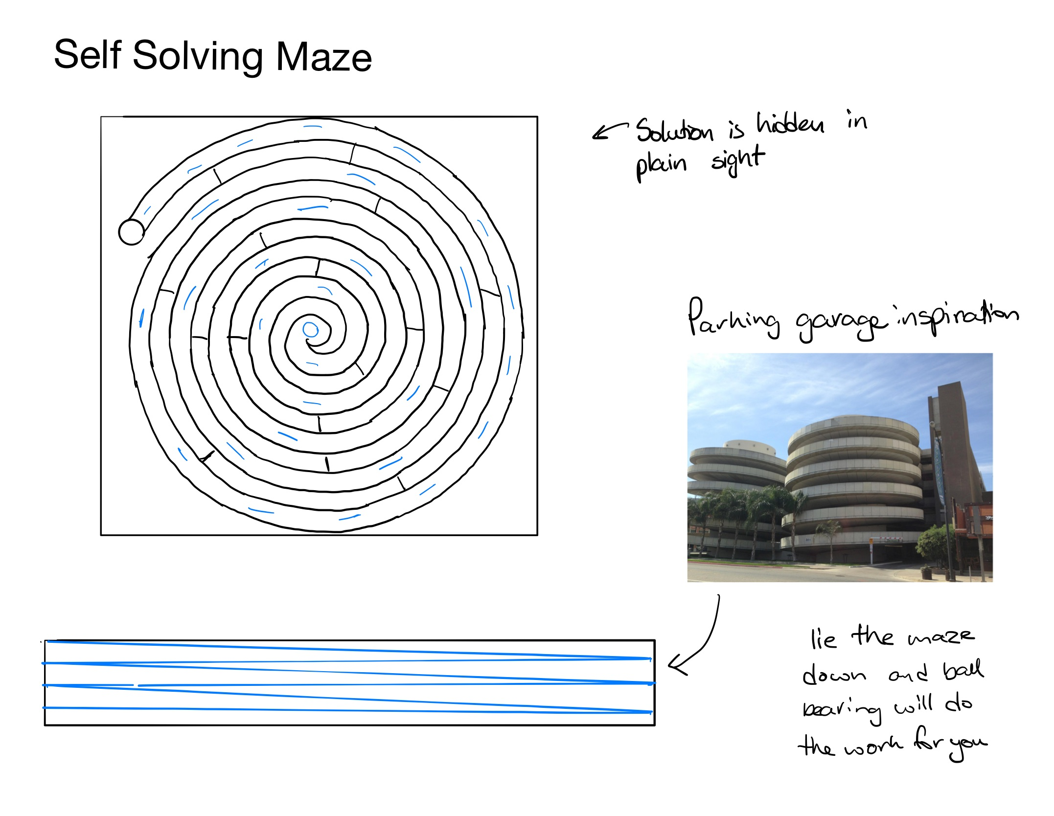

Slide 9
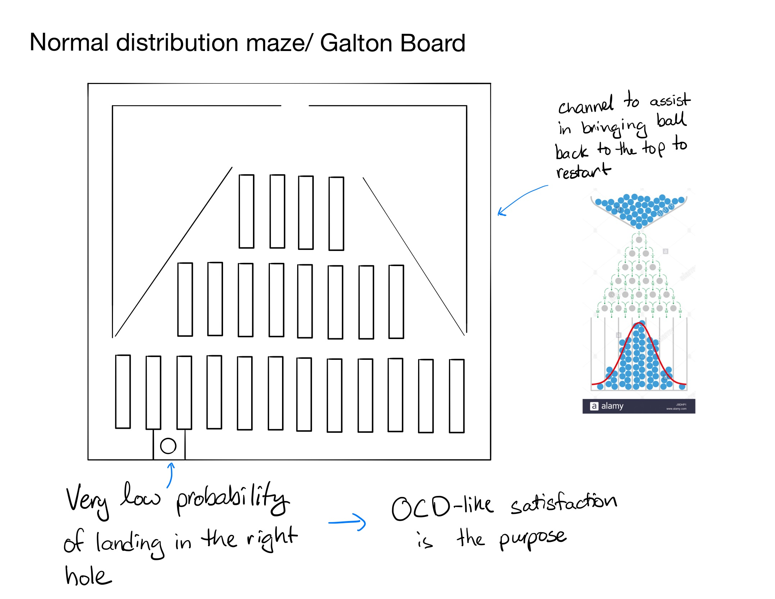

Slide 10
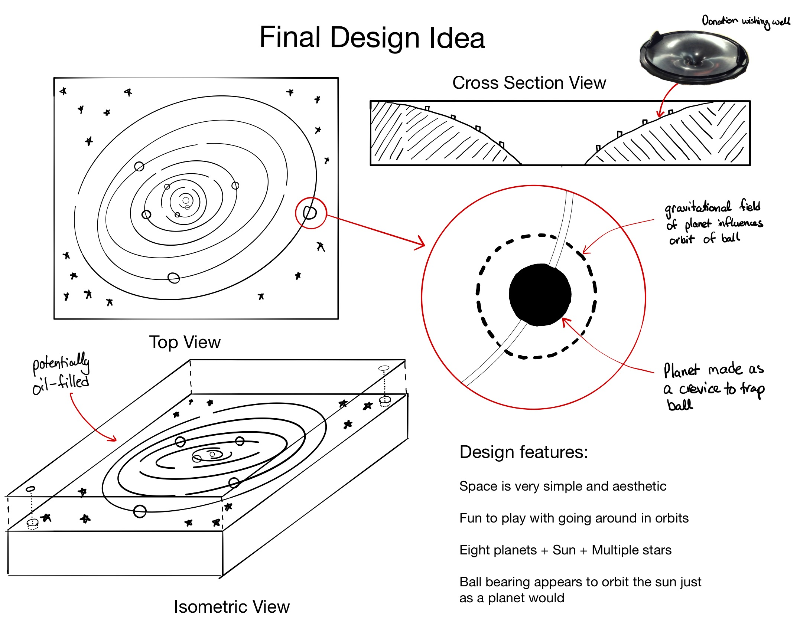

Slide 11
